Slide 1
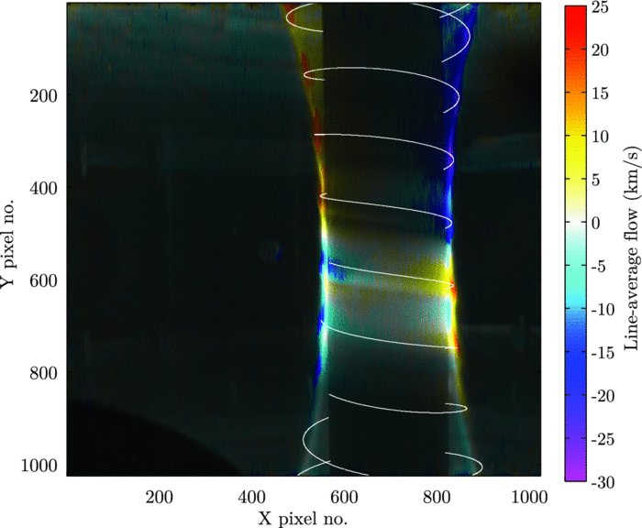
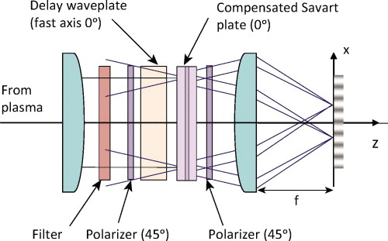
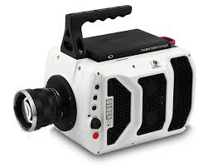
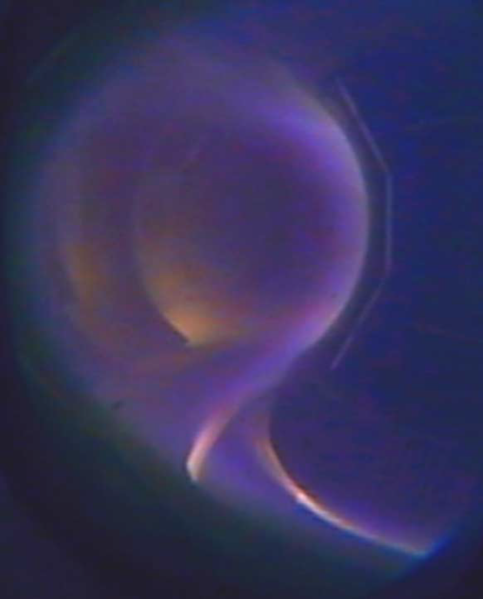


Motional Stark Effect Measurements on MAST-U
S. Gibson (sam.gibson@durham.ac.uk)
Centre for Advanced Instrumentation, Department of Physics, Durham University, DH1 3LE
A coherence imaging diagnostic is being designed for use on China's HL-2A tokamak, for high temporal resolution Doppler flow measurements of impurities in the scrape-off-layer. The diagnostic will at first focus on imaging C III and C II flows along field lines in a small region in the scrape-off-layer, with a 20kHz or better frame rate. The system is being designed with the intention of expanding to wider viewing angles, and imaging of He II impurity.
Coherence Imaging
Instrument Design
Coherence Imaging is a Fourier transform spectroscopic technique.
Light emitted by impurity species in the plasma is analysed through an polarising interferometer to measure Doppler shift, so velocity towards or away from the camera can be measured.
Light from the plasma is first collimated, then travels through the interferometer and is then focused onto the detector.
The first polariser ensures that the light is split evenly through the fast and slow axes of the waveplates.
The light then passes through a delay waveplate made of a birefringent crystal, which gives a fixed path difference between it’s fast and slow axis. The thickness of the plate is typically 1500-2000 wavelengths.
A Savart plate then gives an additional path difference which varies in one axis.
The light then gets interfered through a second polariser and focused onto the detector.
An FFT based demodulation is then used to extract intensity and phase information at each image point.
This technique has been used to measure flow of impurities in UK’s MAST tokamak.[1]
With a wide field of view, measurements at MAST achieved flow resolution of ~1km/s at 1kHz framerate with 1cm spatial resolution.
Fig 1. Flow profile of CIII around the centre column of MAST, with superimposed magnetic field lines in white.[1]
HL-2A
Fig 3. Phantom v2010 camera.
HL-2A is a conventional tokamak based at the South West Institute of Physics (SWIP) in Chengdu, China.
Major radius 1.65m, Minor radius 0.4m.
The diagnostic port available uses optical fibres to view a 13cm square of the scrape-off-layer.
Fig 2. Optical layout of a spatial heterodyne coherence imaging instrument. [2]
This view will give us the ability to view the SOL in high detail.
We hope to view impurity flow at the plasma edge during fast plasma events, such as H-L mode transition and ELMs.
The detector available is a Phantom v2010 camera.
At full view, 1280x800px it will record in 22.5kHz.
When windowed down to 512x512px it will reach 68kHz, and up to 1MHz at 128x38.
This will enable us to capture edge plasma events at a very small timescale
Summary
Coherence imaging is a compact diagnostic system which allows easy adjustments due to its simple design.
Its use has been demonstrated in to produce high temporal and spatial resolution impurity flow profiles.
It allows spatial and spectral information on one 2D image.
A similar system could be designed to measure Stark broadening, allowing electron density profiles to be obtained.
Fig 5. Plasma Configuration of HL-2A. [3]
Fig 4. Image of midplane diagnostic port into HL-2A. Image courtesy of SWIP.
This work is supported by an EPSRC research studentship under grant EP/L01663X/1.
[1] Silburn, S., et. al. Rev. Sci. Instrum. 85, 11D703 (2014)
[2] Howard, J., et al. Rev. Sci. Instrum. 81(10), 10E528 (2010)
[3] D. Liu et al., Fusion Eng. Des. 74 (2005)167-170

